Slide 1
Depth of Knowledge Vocabulary List 2
List 2
Objective: The purpose of this lesson is to help student learn how to dissect language in order to better understand question by using academic vocabulary!
I know they’ve learned it when they pass weekly exams on vocabulary comprehension.

Slide 2
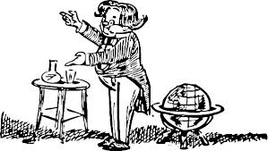
Demonstrate (also Show)
to make evident or establish by arguments or reasoning; prove:
Demonstrate your knowledge of
the solar system in a chart as well
as an essay.

Slide 3
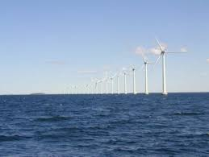
Generate
to bring into existence; cause to be; produce.
to create by a vital or natural process.
Generate questions to survey
students lunch time eating habits.

Slide 4
Investigate
to examine, study, or inquire into systematically; search or examine into the particulars of; examine in detail.
Investigate the effects of drought in order to prepare recommendations for the health of the Utah wetlands.

Slide 5
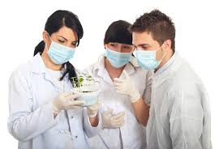
Examine
to inspect or scrutinize carefully:
Examine the cells to locate
any abnormalities.

Slide 6
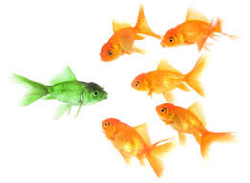
Differentiate
to change; alter.
to perceive the difference in or between.
to make different by modification
Differentiate the changes to an experiment necessary to alter
one variable.

Slide 7
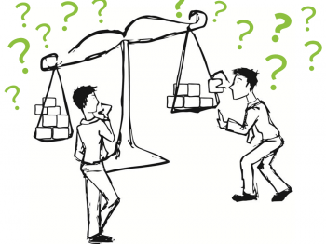
Determine
to figure, to settle or decide, conclude or ascertain after reasoning, observation, finding evidence, etc.
Use the formula for rise over run
to determine the rate of
change on the slope.

Slide 8
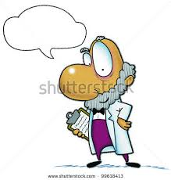
Hypothesize (also Claim or Thesis)
to form a proposition, or set of propositions, set forth as an explanation for the occurrence of some specified group of phenomena based on reason and preliminary evidence or data
Using the data collected, hypothesize on the current and future health of the stream.

Slide 9
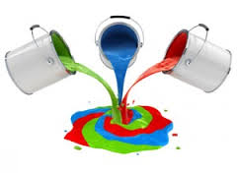
Integrate
to make connections,
to unite or combine.
Integrate knowledge
of foods and diet to
propose a wellness
plan for your family.

Slide 10
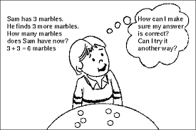
Justify
to defend or uphold as warranted or well-grounded
Justify the proposal for
teachers to be permitted
to carry guns while on the
job.

Slide 11
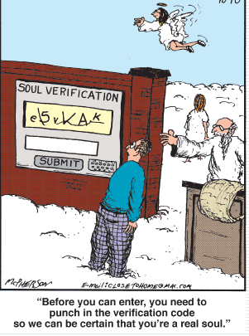
Verify
to prove the truth of,
as by evidence or testimony;
confirm; substantiate
Verify your answers to the test
are correct before clicking
“submit.”

Slide 12
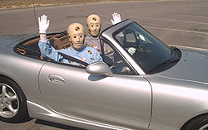
Conduct
to direct in action or course; manage; carry on
Conduct an experiment to create changes in sleep patterns.

Slide 13
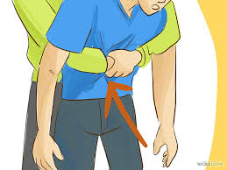
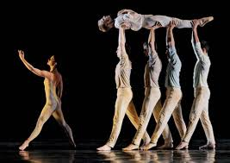
Perform
to carry out; execute; do:
Perform the music
during practice and rehearsal
the way you intend to play
it in a live concert.

Slide 14
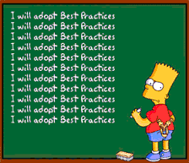
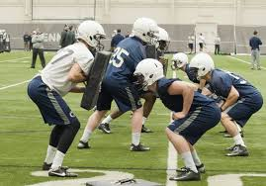
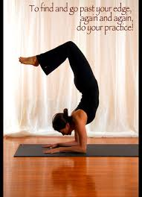
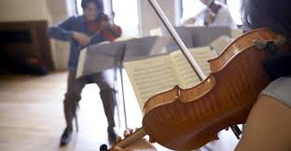
Practice
repeated performance or systematic exercise for the purpose of acquiring skill or proficiency:
Practice makes permanent
Practice the use of smooth
transitions in all forms of writing.

Slide 15
Relate
to tell; give an account of (an event, circumstance, etc.).
to bring into or establish association, connection, or relation :
Relate the events of the story chronologically.

Slide 16
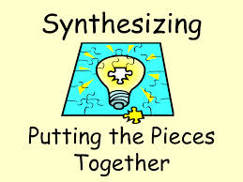
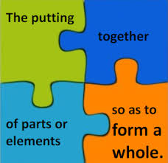
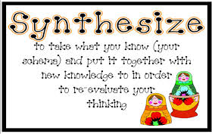
Synthesize
to form a product by combining parts or elements: to combine into a single or unified entity.
Synthesize the story using
music, dance, and costumes.

Slide 17
Suggestion for an Activity: Part 1 Concept Circles (Dr. Janet Allen)
Use any 5 words with each of the following three activities:
Concept Circles: Look at the items in the concept circle. Write about your understanding of (vocabulary word) by highlighting the connections between and among each of the items in the concept circle. What is the significance of each one and how do the items in the concept circle fit together?
Complete one Concept Circle for each of the 5 words, choose your words carefully!
___________________________________________________________________________________________________________________________________________________________________________________________________________________________________________________________________________________________________________________________________________________________________________________________________________________________________________________________

Slide 18
Part 2: Academic Vocabulary Cards (Dr. Janet Allen)
Information from the Teacher (Definition, Context, Examples) | Restate in My Own Words
Additional Information from Reading, Viewing, Discussion | Mnemonic to Help Me Remember (Visual, Jingle, etc.)

Slide 19
Synonyms & Antonyms
Vocabulary Words | Synonyms | Antonyms
Word 1:
Word 2:
Word 3:
Word 4:
Word 5:

